Slide 1

[LGBIO2020] TP3 - CLASSIFICATION

Slide 2
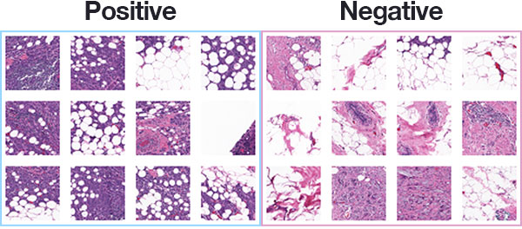
Context - The dataset
We want to design a machine learning tool able to predict if histological images of cells correspond to malignant or benign tumor.
Features are computed directly with a program analyzing cytological images:
1 - Radius
2 - Texture
3 - Perimeter
4 - Area
5 - Smoothness
6 - Compactness
7 - Concavity
8 - Concave points
9 - Symmetry
10- Fractal dimension
Mean, std and largest values of these features are computed, resulting in 30 features.
What is Deep Learning ?

Slide 3
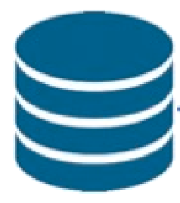



Machine Learning Pipeline
Look at the data
Feature Extraction/Selection
Train the models
Evaluate the models
A good starting point is to look at your data to identify some specificities: - are they NAN values? - are some features more discriminative than other?
The number of features can be extremely high. It is often needed to either: - Select the most relevant features - Create (Extract) new features from existing while decreasing the dimensionality
Thanks to the validation set, estimate the best parameter of your models.
Thanks to the test set, evaluate the performances of the models with the best parameters

Slide 4
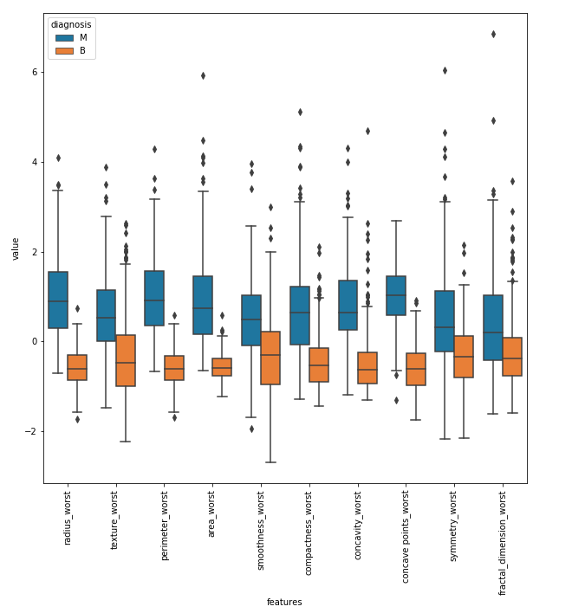
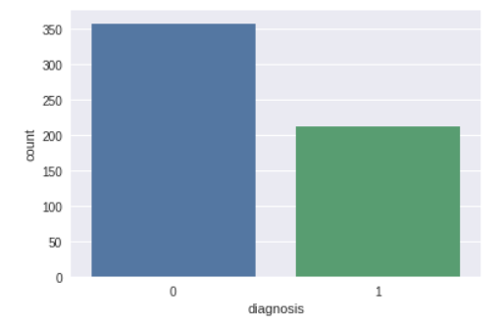
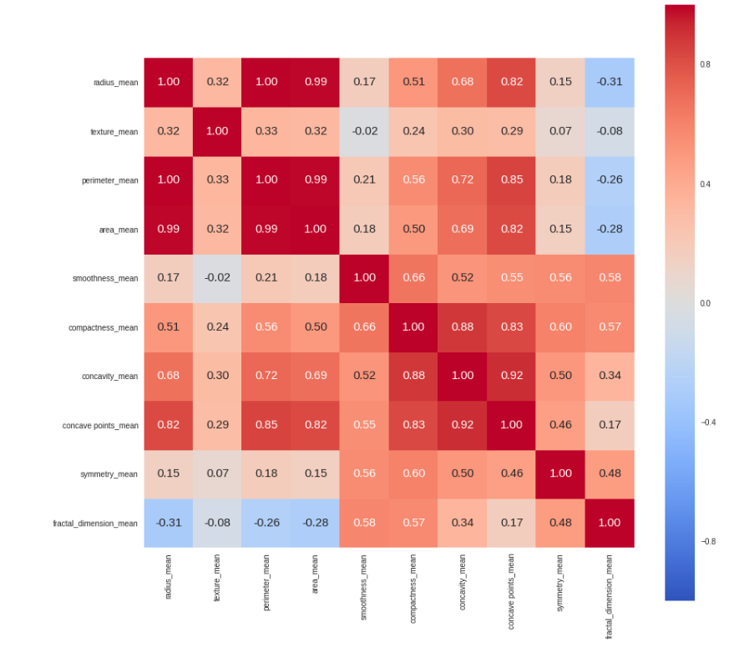
Look at the Data
Box plot Class Imbalance Correlation Matrix

Slide 5
Machine Learning Pipeline
Look at the data
Feature Extraction/Selection
Train the models
Evaluate the models
A good starting point is to look at your data to identify some specificities: - are they NAN values? - are some features more discriminative than other?
The number of features can be extremely high. It is often needed to either: - Select the most relevant features - Create (Extract) new features from existing while decreasing the dimensionality
Thanks to the validation set, estimate the best parameter of your models.
Thanks to the test set, evaluate the performances of the models with the best parameters

Slide 6
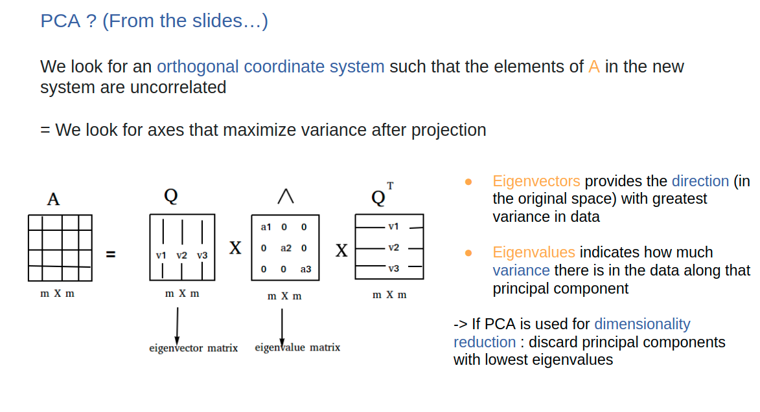
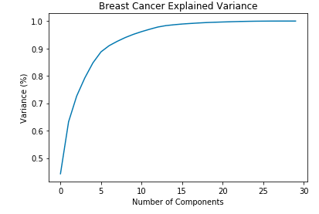
Feature Selection
Keep the features that correlates the most with the target.
Feature Extraction
Recall PCA Keep n components of PCA that corresponds to a given % of explained variance

Slide 7
Machine Learning Pipeline
Look at the data
Feature Extraction/Selection
Train the models
Evaluate the models
A good starting point is to look at your data to identify some specificities: - are they NAN values? - are some features more discriminative than other?
The number of features can be extremely high. It is often needed to either: - Select the most relevant features - Create (Extract) new features from existing while decreasing the dimensionality
Thanks to the validation set, estimate the best parameter of your models.
Thanks to the test set, evaluate the performances of the models with the best parameters

Slide 8
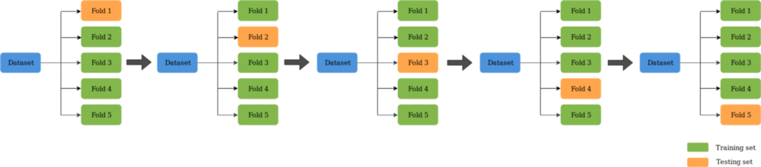
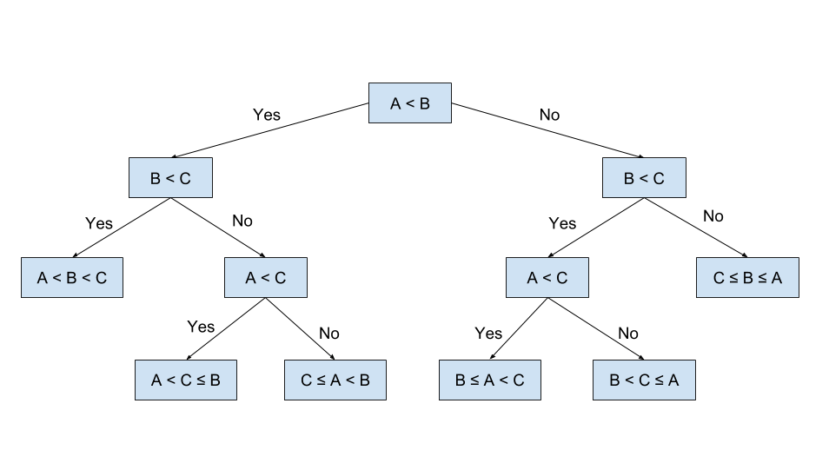
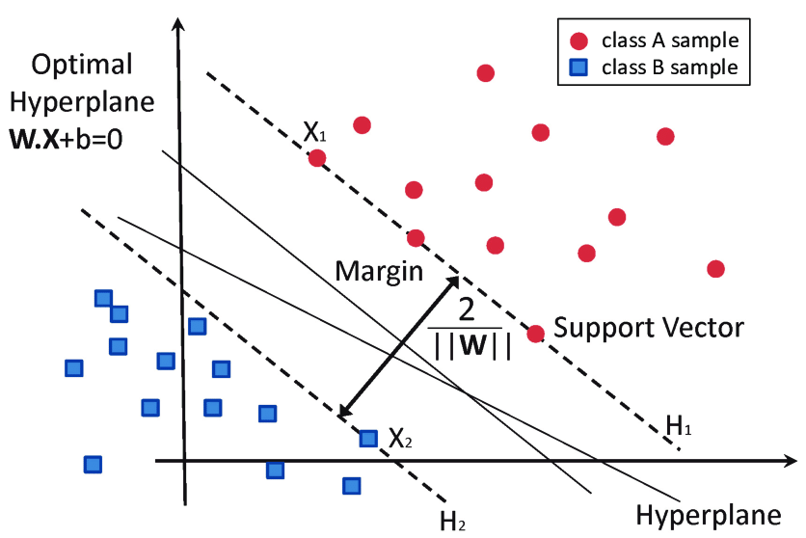
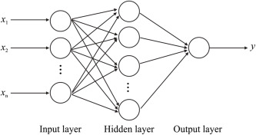
K-Fold validation
Decision Tree Neural Networks (MLP) SVM

Slide 9
Machine Learning Pipeline
Look at the data
Feature Extraction/Selection
Train the models
Evaluate the models
A good starting point is to look at your data to identify some specificities: - are they NAN values? - are some features more discriminative than other?
The number of features can be extremely high. It is often needed to either: - Select the most relevant features - Create (Extract) new features from existing while decreasing the dimensionality
Thanks to the validation set, estimate the best parameter of your models.
Thanks to the test set, evaluate the performances of the models with the best parameters

Slide 10
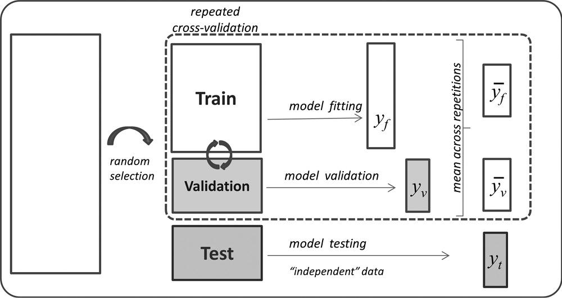
Use a test set to evaluate the model performances

Slide 11
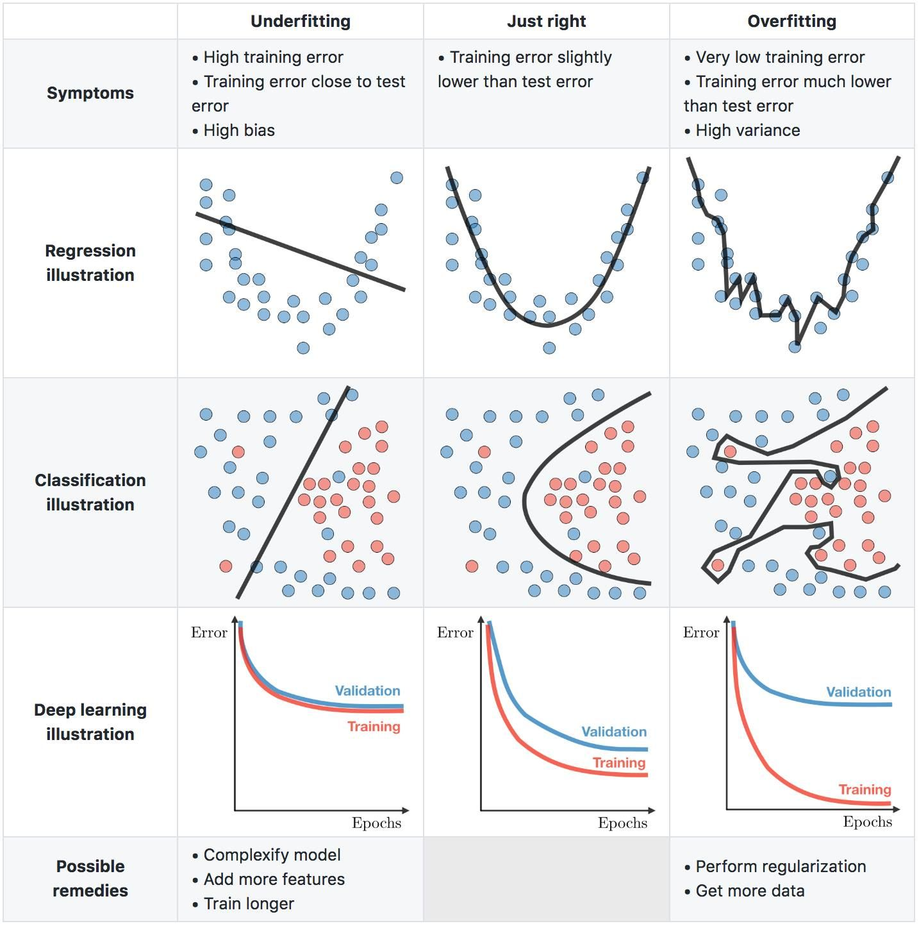
Data scientist nightmare -> Overfitting

